Slide 1
JNCIS-ENT
Layer 2 security and loop prevention

Slide 2
Storm Control and Firewall Filters
10
Traffic inspection and access control

Slide 3

A Network Storm
When a large amount of broadcast or multicast traffic is generated, significant performance impact can be seen for hosts on the network
This may occur due to a forwarding loop, malfunctioning device or software
Hosts on the network must process broadcasts
Possible to utilize all available forwarding bandwidth on a switch

Slide 4
Storm Control
Storm control will monitor the rate that BUM traffic is received on a port and take action if the configured maximum rate is exceeded
Default rate is 80% of the interface line rate
Storm control can either drop offending traffic or shutdown an interface
user@switch1> show configuration forwarding-options
storm-control-profiles default {
all;
action-shutdown;
}
user@switch1> show configuration interfaces ge-0/0/1.0
family ethernet-switching {
vlan {
members default;
}
storm-control default;
recovery-timeout 300;
}
Notes:
Default is to drop the offending traffic

Slide 5
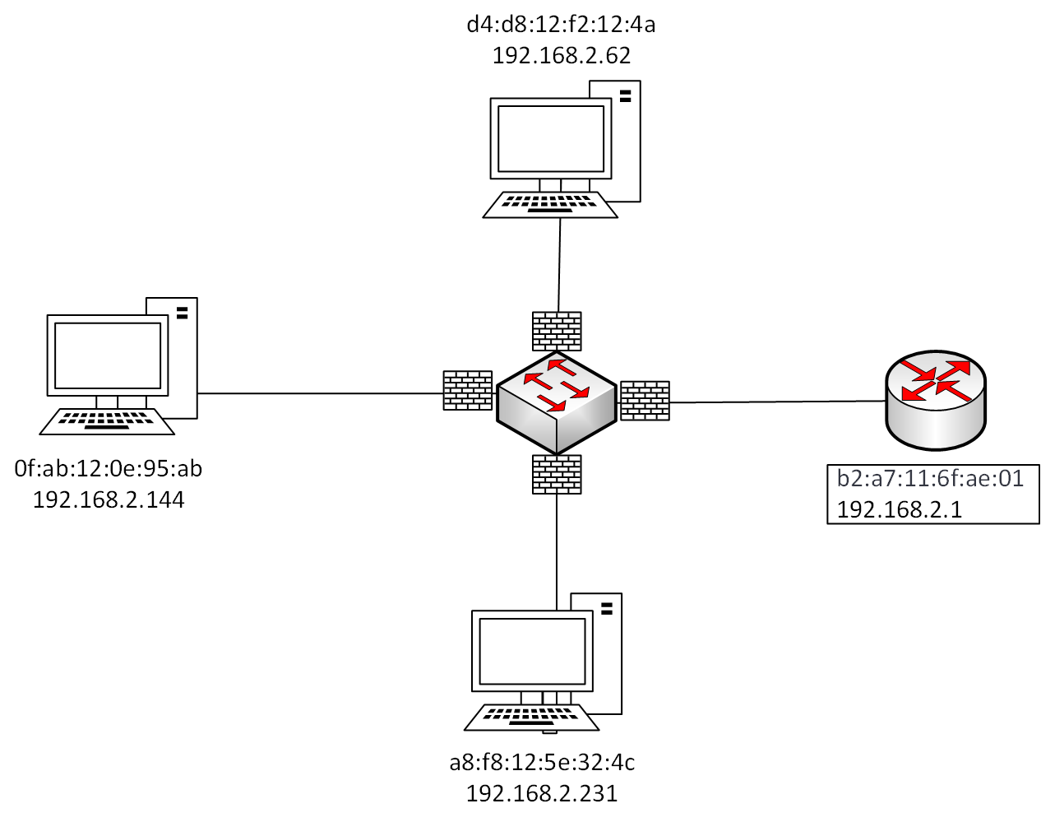
Firewall Filter Review
Firewall filters, also referred to as Access Control Lists (ACLs) by other vendors, control traffic entering or leaving a network device
Firewall filters are stateless, meaning they cannot ‘remember’ session information or other ‘state’ to act on flows, but rather inspects each packet individually
Only a single firewall filter may be applied per direction per port or VLAN
Firewall filters are implemented at the ASIC level in hardware
Filters are programmed into the PFE and enforced there without RE processing

Slide 6
Firewall Filter Types
EX switches support 3 types of firewall filters
Port based
VLAN based
Router based
Filter Type | Description
Port based | Applied ingress or egress on a particular switchport
VLAN based | Applied ingress or egress to an entire VLAN
Router based | Applied ingress or egress to a layer 3 routed interface
user@switch1# set firewall family ?
Possible completions:
> any Protocol-independent filter
> ethernet-switching Protocol family Ethernet Switching for firewall filter
> inet Protocol family IPv4 for firewall filter
> inet6 Protocol family IPv6 for firewall filter

Slide 7
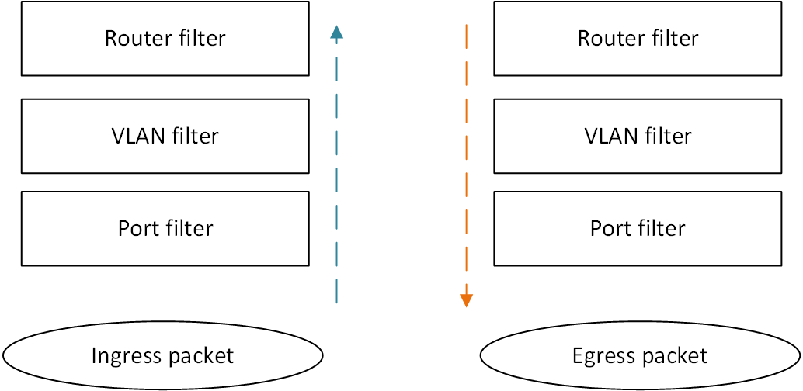
Firewall Filter Processing
On ingress, filters are processed starting at the port, then VLAN, then router
On egress, filters are processed in the reverse order
Filters applied to an IRB interface are router filters and do not apply to packets traversing within a VLAN

Slide 8
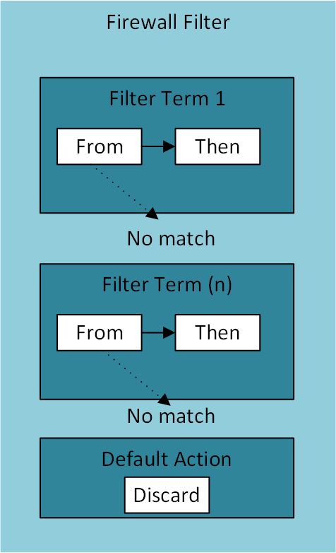
Firewall Filter Configuration 1
Filters consist of terms which match traffic in from statements and perform the then action on the traffic
If no terms match the inspected traffic, the default action will discard the packet
The default action is not displayed, leading to the common description of ”implicit discard”
Because firewall filters are stateless, you must explicitly allow desired traffic in both directions

Slide 9
Firewall Filter Configuration 2
user@switch1# set firewall family ethernet-switching filter my_filter term test_term1 from ?
Possible completions:
+ apply-groups Groups from which to inherit configuration data
+ apply-groups-except Don’t inherit configuration data from these groups
> destination-mac-address Match MAC destination address
+ destination-port Match TCP/UDP destination port
> destination-prefix-list Match IP destination prefixes in named list
+ Dscp Match Differentiated Services (DiffServ) code point
+ ether-type Match Ethernet Type
> flexible-match-mask Match flexible mask
> flexible-match-range Match flexible range
fragment-flags Match fragment flags
+ icmp-code Match ICMP message code
+ icmp-type Match ICMP message type
> interface Match interface name
> ip-destination-address Match IP destination address
+ ip-precedence Match IP precedence value
+ ip-protocol Match IP protocol type
> ip-source-address Match IP source address
> ip-version Define IP version
is-fragment Match if packet is a fragment
+ l2-encap-type Match Ethernet Encapsulation type
.
.
.

Slide 10
Firewall Filter Configuration 3
user@switch1# set firewall family ethernet-switching filter my_filter term test_term1 then ?
Possible completions:
accept Accept the packet
analyzer Name of analyzer - (Ingress only)
+ apply-groups Groups from which to inherit configuration data
+ apply-groups-except Don't inherit configuration data from these groups
count Count the packet in the named counter
discard Discard the packet
forwarding-class Classify packet to forwarding class
log Log the packet
loss-priority Packet's loss priority
next Continue to next term in a filter
policer Name of policer to use to rate-limit traffic
port-mirror Port-mirror the packet
port-mirror-instance Port-mirror the packet to specified instance
syslog System log (syslog) information about the packet
vlan Name of VLAN - (Ingress only)

